Slide 1

Building for the Modern Web with JavaScript Applications
Allen Conway
Lead Consultant
Magenic
Level: Intermediate

Slide 2

Intro
Allen Conway
Blog: http://www.AllenConway.net
Twitter: @AllenConway, http://www.twitter.com/AllenConway
GitHub: https://github.com/AllenConway
Email: AllenC@Magenic.com

Slide 3

Target Objective
JavaScript Web Applications
What exactly is a Modern Web App?
Why JS Applications are viable
JS Applications vs. ASP.NET
Progressing to the Modern Web App
The Web Stack
Responsive Web Design
AngularJS + TypeScript
Azure Websites and Mobile Services
ASP.NET Web Pages
Web API
SignalR

Slide 4
Let’s get things rolling
“To say that SPA development is the future is an extreme understatement”
Long Le, MSDN Magazine (March 2014)
“Yep – I agree.”
Allen Conway (present day)

Slide 5
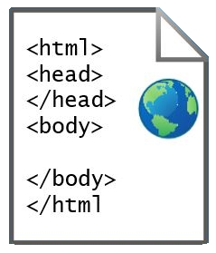
What exactly is a JS Web App??
a.k.a Single Page Applications
What’s with the ‘Single Page’ – Do I have to do everything in 1 page?
HTML web page “shell” is sent once to the browser

Slide 6
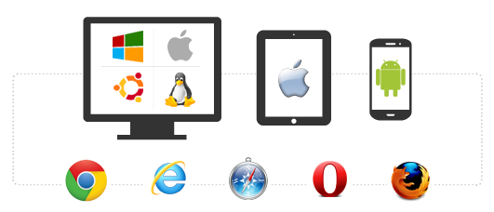
Cross Browser, Platform, Device
JavaScript Applications + Responsive design
Browser and device agnostic
Best on browsers supporting HTML5 and CSS3
http://caniuse.com/
More accepted on mobile devices
JavaScript will rule the world!!
Should I go to the web?
Native per platform
Xamarin
Hybrid/PhoneGap
http://magenic.com/Resources/ID/2

Slide 7
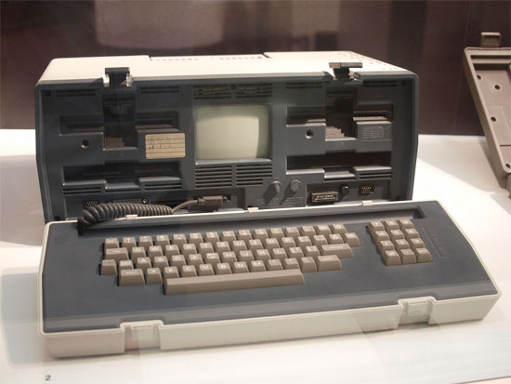
MyVote – Modern Web Application DEMO
JS Apps can run on almost anything with a modern browser!

Slide 8

How are JavaScript Applications different from ASP.NET MVC or Webforms?
Shift in application logic from the server to the client
UI and application logic is now done in the browser
How HTML is delivered
ASP.NET web apps merge data with HTML before delivering to the client
Server’s main responsibility: Data
JavaScript MV* Frameworks

Slide 9
Where did we come from?
Static DOM
Static DOM
Static DOM
Static/Dynamic
DOM
Code-Behind
Controller
Controller
Services / Data

Slide 10
The Modern Web: JS Applications
Master Layout
Model
View
(Dynamic DOM)
Controller
Services
Renderer
Services / Data

Slide 11


JS Applications in the Enterprise
Well-known JavaScript Applications
Instagram, Weather.com, Walgreens, MSNBC
Making that accounting, shipment tracking, inventory, etc. application as a SPA
Considerations before making that next application a modern web application

Slide 12

Why JavaScript Web Applications are… AWESOME
Lean, mean, fighting machines!
Fluid and responsive
Narrowing the line between desktop and web from UX perspective
Mature browsers
HTML5
CSS3
JS Processing
JavaScript Frameworks follow familiar patterns

Slide 13

Disadvantages and Challenges of JS Web Applications
Frameworks are volatile
Take notice: JavaScript is required
Sea of JS frameworks for creating modern web apps
Years of working almost exclusively in managed code on the server (C#/VB.NET)
Mindset of doing so much on the client
Difference in the way of thinking about web design

Slide 14

Common Misunderstandings of JS Apps
Not SEO friendly because there is no static content to crawl
I can’t have deep linking
I have 25+ pages in my app not a ‘single page’
JS Frameworks are fads that will be gone in 5 years

Slide 15

The MyVote Technology Stack
HTML5/CSS3 Responsive Design
AngularJS + TypeScript
Azure Web Sites and Azure Mobile Services
ASP.NET Web Pages (not MVC!)
ASP.NET Web API
CSLA
Azure SQL Server

Slide 16

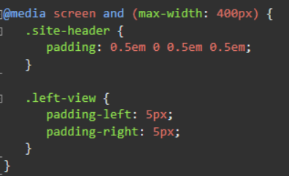
Responsive Design
Further elevate your code :: eyeball ratio
Foot in the door for mobile devices
Invest in your base template
Core technique: CSS Media Queries (CSS3)
Tools for testing
Frameworks
Bootstrap (LESS)
Foundation (SASS)

Slide 17
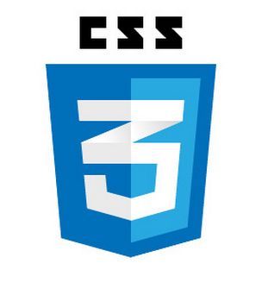

MyVote - Responsive Web Design DEMO

Slide 18

JavaScript and the Modern Web
Let’s not sugar coat it – we need JS
Prototypical Language
Object.prototype.__proto__
Follow mainstream JS patterns
Classes
Modules (Module & Revealing Module Patterns)
Closures
Promises
Leverage JS frameworks and Libraries
AngularJS
Aurelia/Durandal
ReactJS
Ember
Backbone

Slide 19
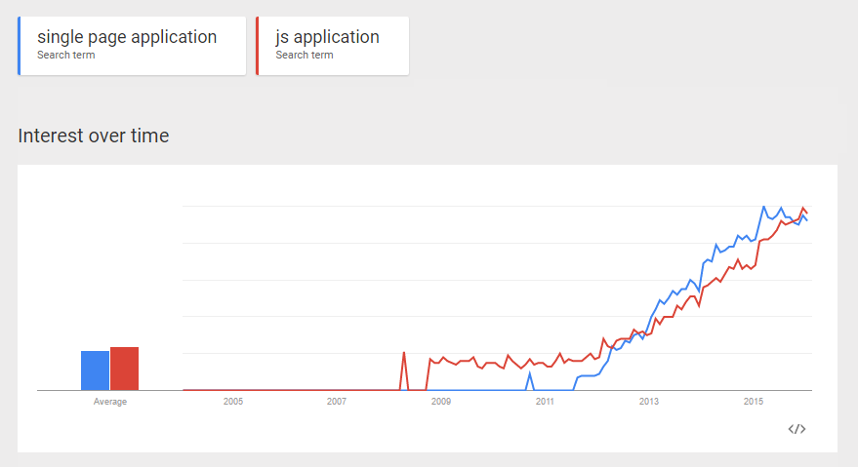
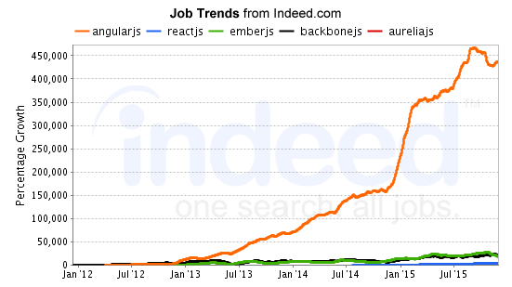
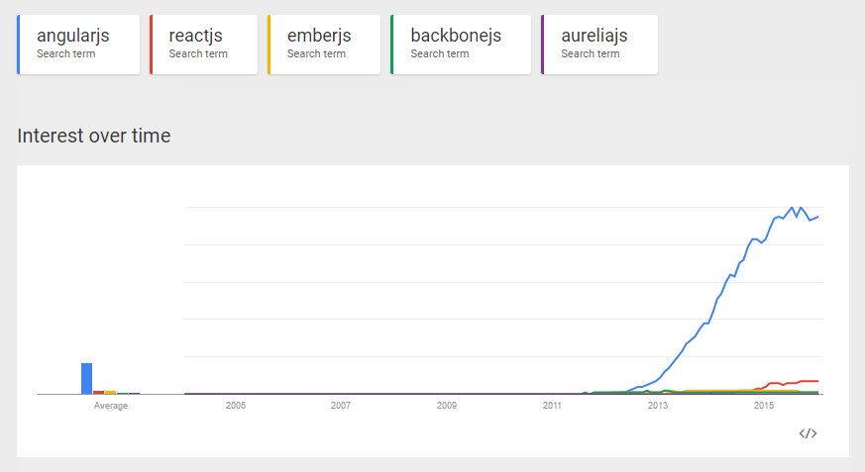
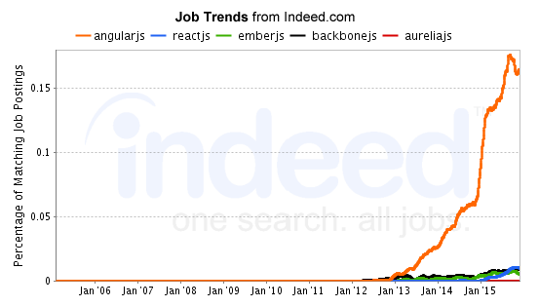
JavaScript Framework Popularity

Slide 20

AngularJS
Complete client side MVW framework for creating JavaScript Applications
Compliments the server
Originally started at Google, now OSS
Declarative style of programming
Manipulating the DOM
Imperative style of programming
Expressing logic
Easy to use and learn

Slide 21
AngularJS 1.x Fundamentals
Comprehensive framework includes:
Data binding
Directives
Templates/Views
Controllers
Models
Services
Custom and Provided
Dependency Injection

Slide 22

What is TypeScript
High level language like JavaScript yet offering familiar OO concepts and techniques
Superset of JavaScript
All valid JavaScript is valid TypeScript
Transpiled to JavaScript
Microsoft chose to build atop JavaScript
Big wins for TypeScript in Angular 2.0 adoption
Offers compile-time checking for type safety
Provides features ahead of ECMAScript Standards
Pick your favorite IDE
Intellisense!

Slide 23
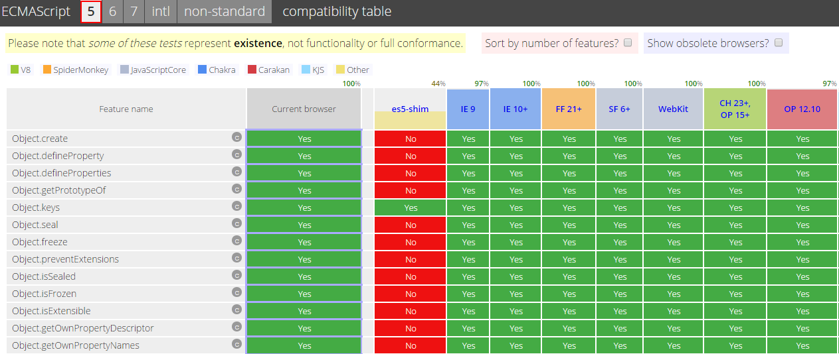
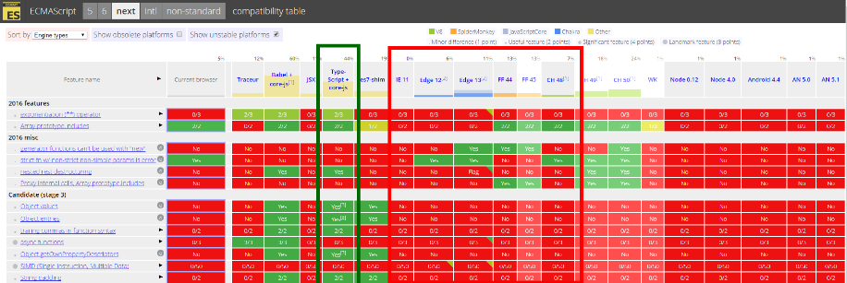
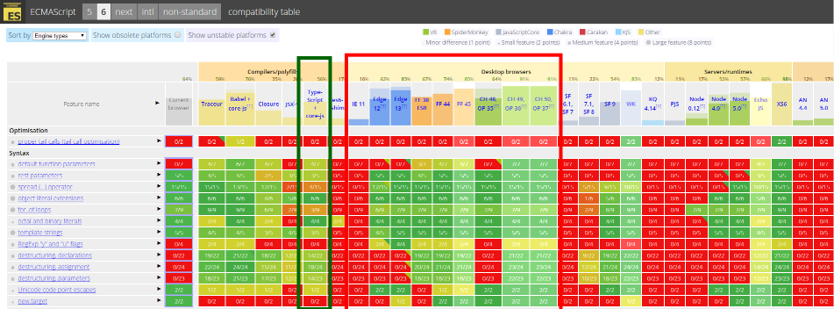
Why TypeScript?
ES5
ES7
ES6
http://kangax.github.io/compat-table

Slide 24
ASP.NET Web API
RESTful services
We can still use C#/VB.NET on the server!
Server holds the cards to providing data to the client
Share same business process to multiple consumers
MVC developer-friendly
AJAX-friendly

Slide 25
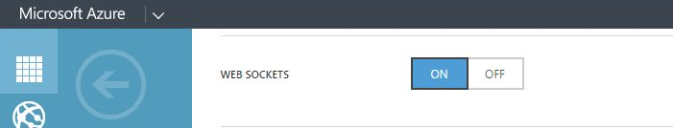
SignalR
Real-time push communication
Notifications, streaming, etc.
Azure Web Sites supports Web Sockets
Leverages existing application’s authentication mechanism

Slide 26
MyVote – AngularJS, TypeScript, SignalR, and Web API DEMO

Slide 27
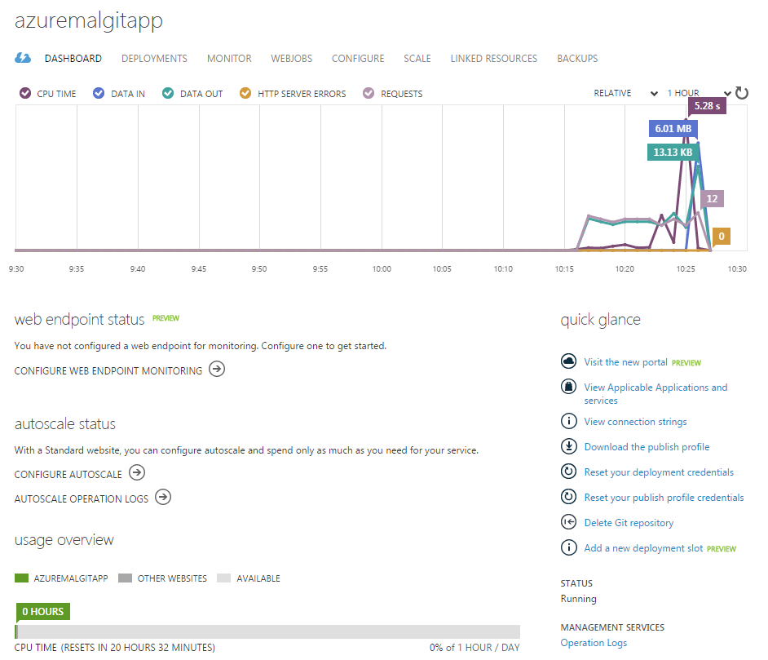

Azure Websites
Host your own web applications
Multiple hosting options
Multiple Source Control Integration Options
Azure Management Portal
Easy to use – no IIS or server to manage

Slide 28

Azure Mobile Services
Platform parity
Facilitate a shared experience
Identity
Data/Sync
Notifications
Backend jobs
Push Notification support
Fastest way to get up and running

Slide 29

Angular 2.0 Primer
Component-Based UI
Angular 1.x Controllers & Directives morph into Components
Better performance
$scope is gone
ng-upgrade = Angular 1.x + 2.0
Migrate more easily

Slide 30

JS Applications Performance
The big payoff – fast, fast, fast and don’t forget… efficient!
Use ‘Network’ tab in debugging tools
Request count
Size
Time
Techniques
Caching
Bundling / Minification
Application Insights

Slide 31
Learning to befriend the Developer Tools
Chrome, IE, Firefox and Safari all have their own developer tools
Chrome has a fantastic set of developer tools
Search for scripts using Ctrl + O
Ability to debug JavaScript and seek out errors easily
Ability to debug Async calls
Manipulate expressions real time to prevent browser refresh

Slide 32
Useful References
MyVote URL
http://myvote.azurewebsites.net
MyVote on GitHub
https://github.com/Magenic/MyVote
Plunker (AngularJS Playground)
http://plnkr.co/
Bootstrap
http://getbootstrap.com/
UI Bootstrap (Angular directives)
http://angular-ui
Azure Mobile Services
http://azure.microsoft.com/en-us/documentation/services/mobile-services/
Azure Pricing
https://azure.microsoft.com/en-us/pricing/details/app-service/
Angular 1.x
https://angularjs.org/
Angular 2.0
https://angular.io/
github.io/bootstrap/
AngularJS API Docs
https://docs.angularjs.org/api
AngularJS Training
http://egghead.io/
http://thinkster.io/
http://www.pluralsight.com/
Angular 1 and Angular 2 information
http://angularjs.blogspot.com/

Slide 33
Not a wrap up!
This is just the Start!
Have references handy
Try things on a small scale
Become familiar with all the pieces
JS Applications and Modern Applications
way of thinking/designing vs. technologies that implement them
JS Frameworks can create large scalable web applications

Slide 34

Questions
Thank you for attending Modern Apps LIVE!

